Slide 1


183 DB Weekly Report
Week 7 Team Parsley
Lin Li, Amir Omidfar, Wilson Chang, Angel Jimenez

Slide 2
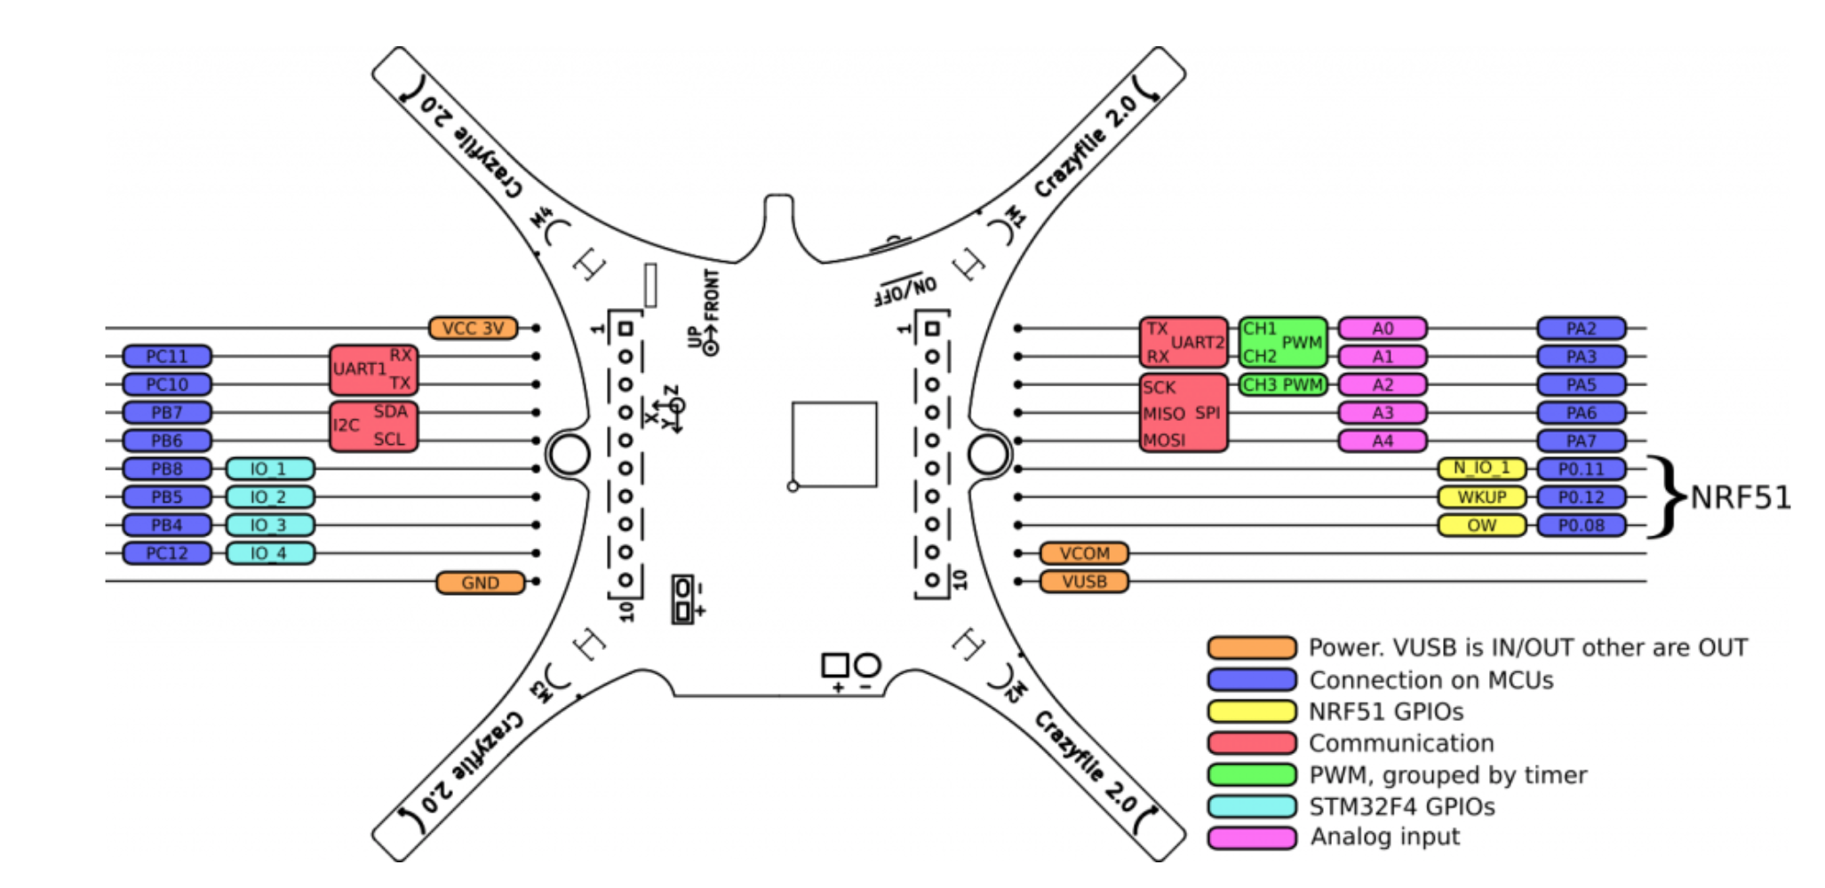
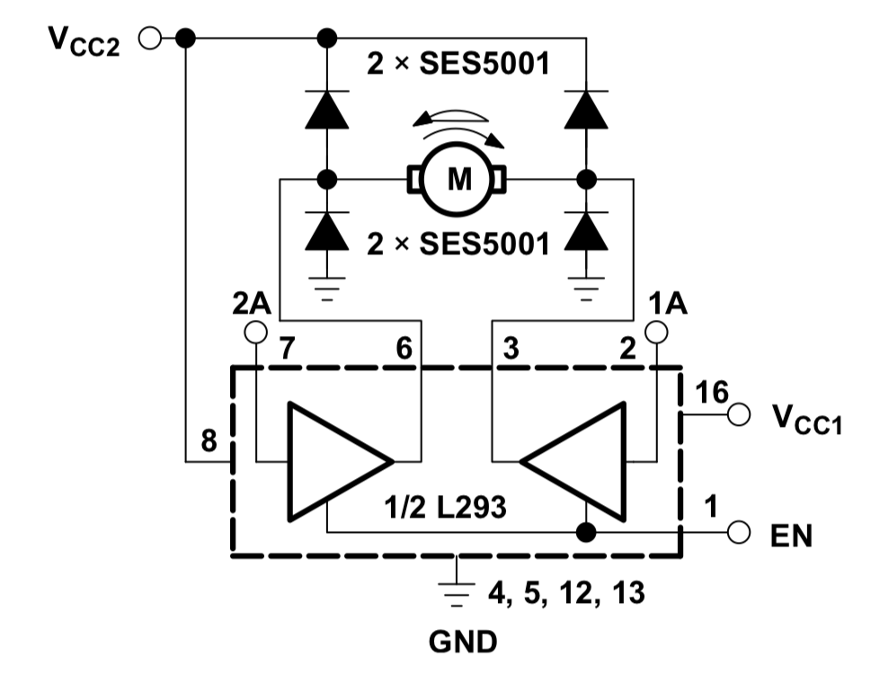
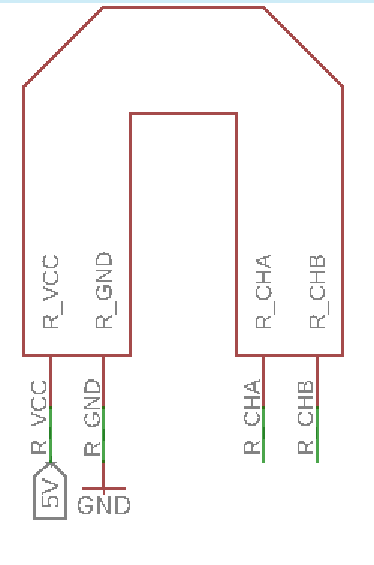
Controller Circuit-Explained
Notes:
Talk about H-bridge and encoders and the pin out designed
Magnetic Field problems

Slide 3
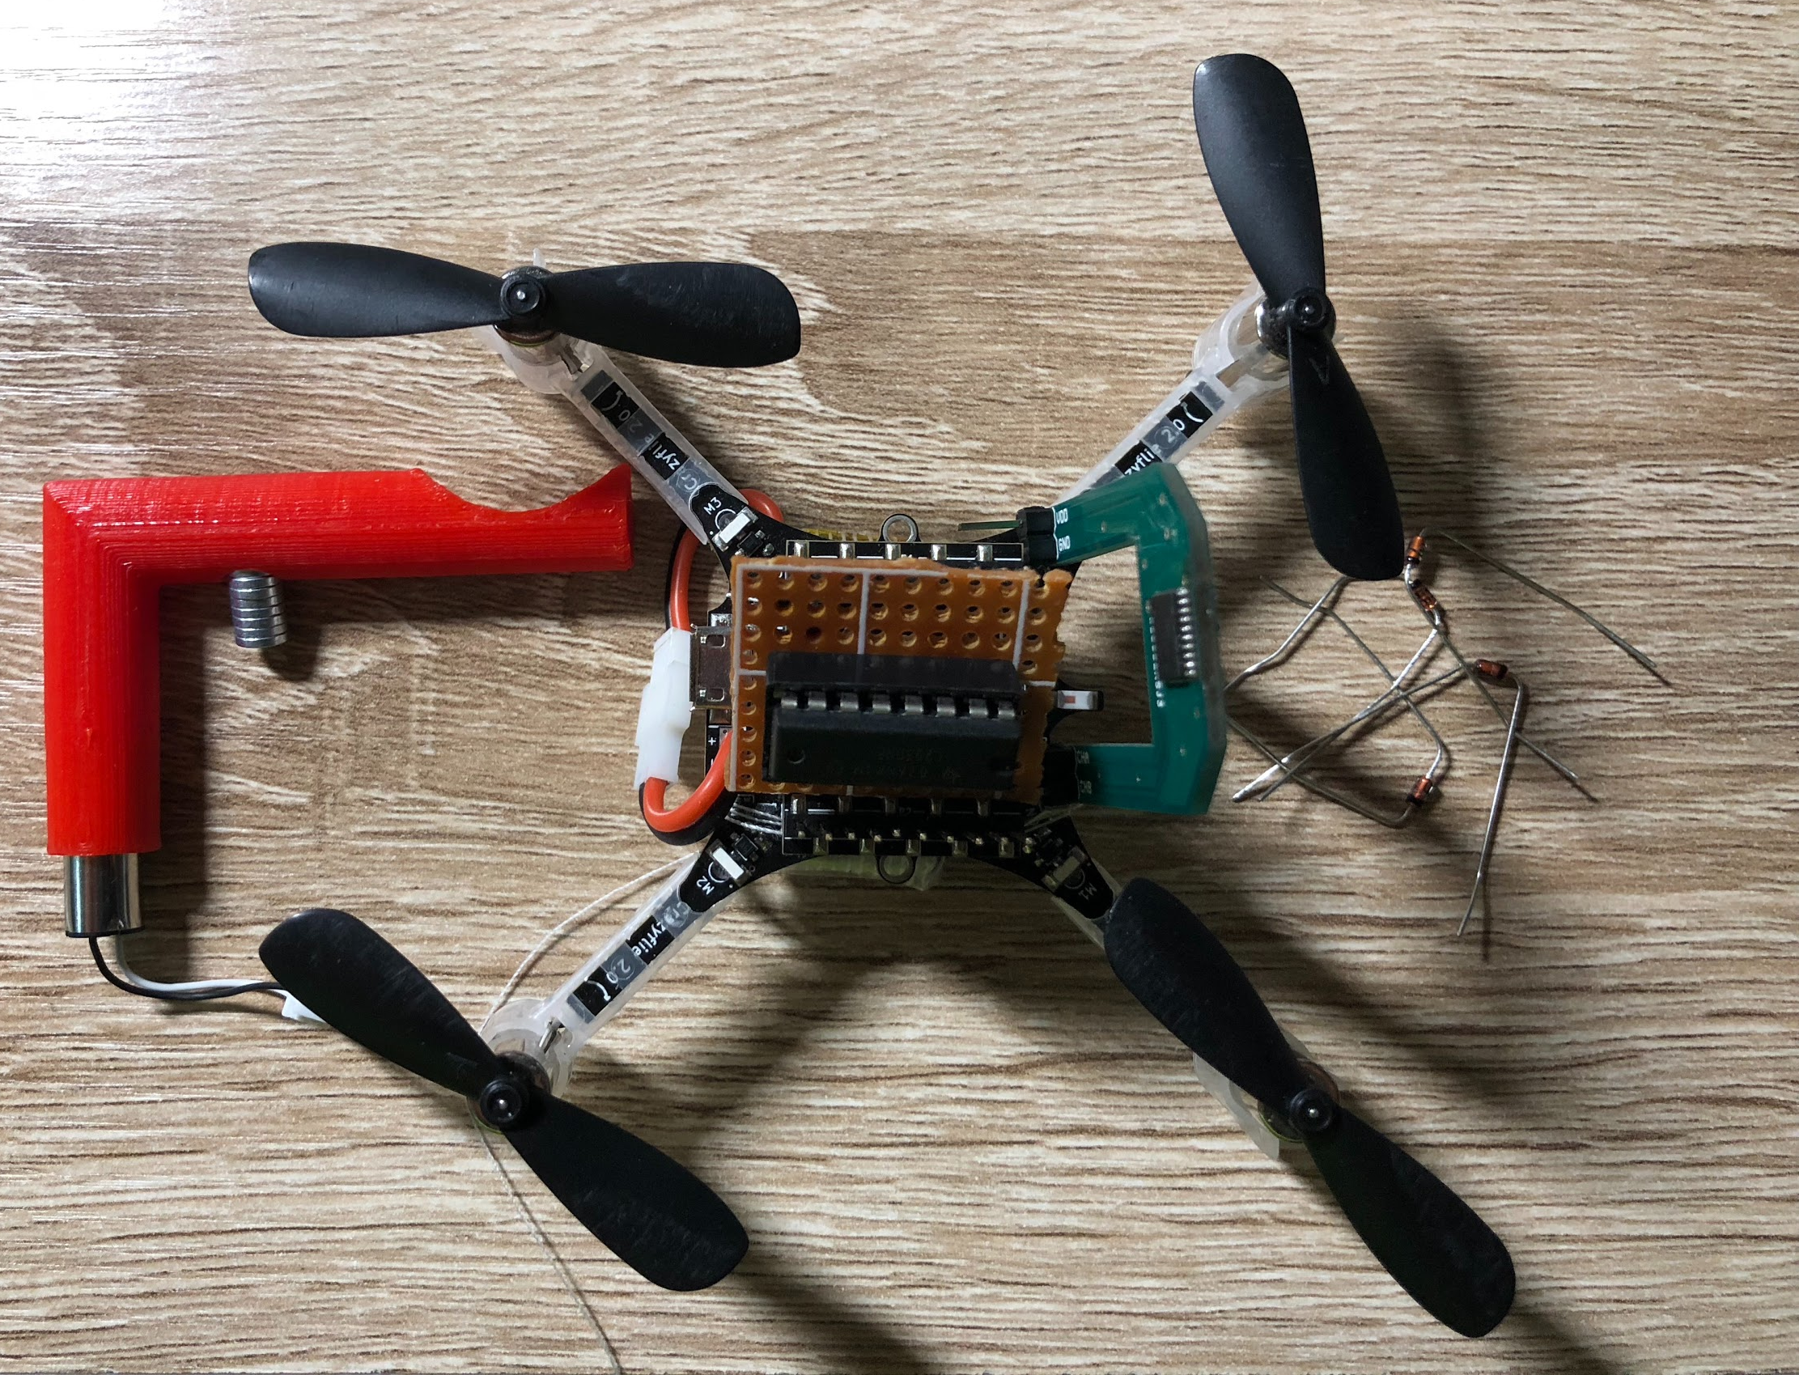
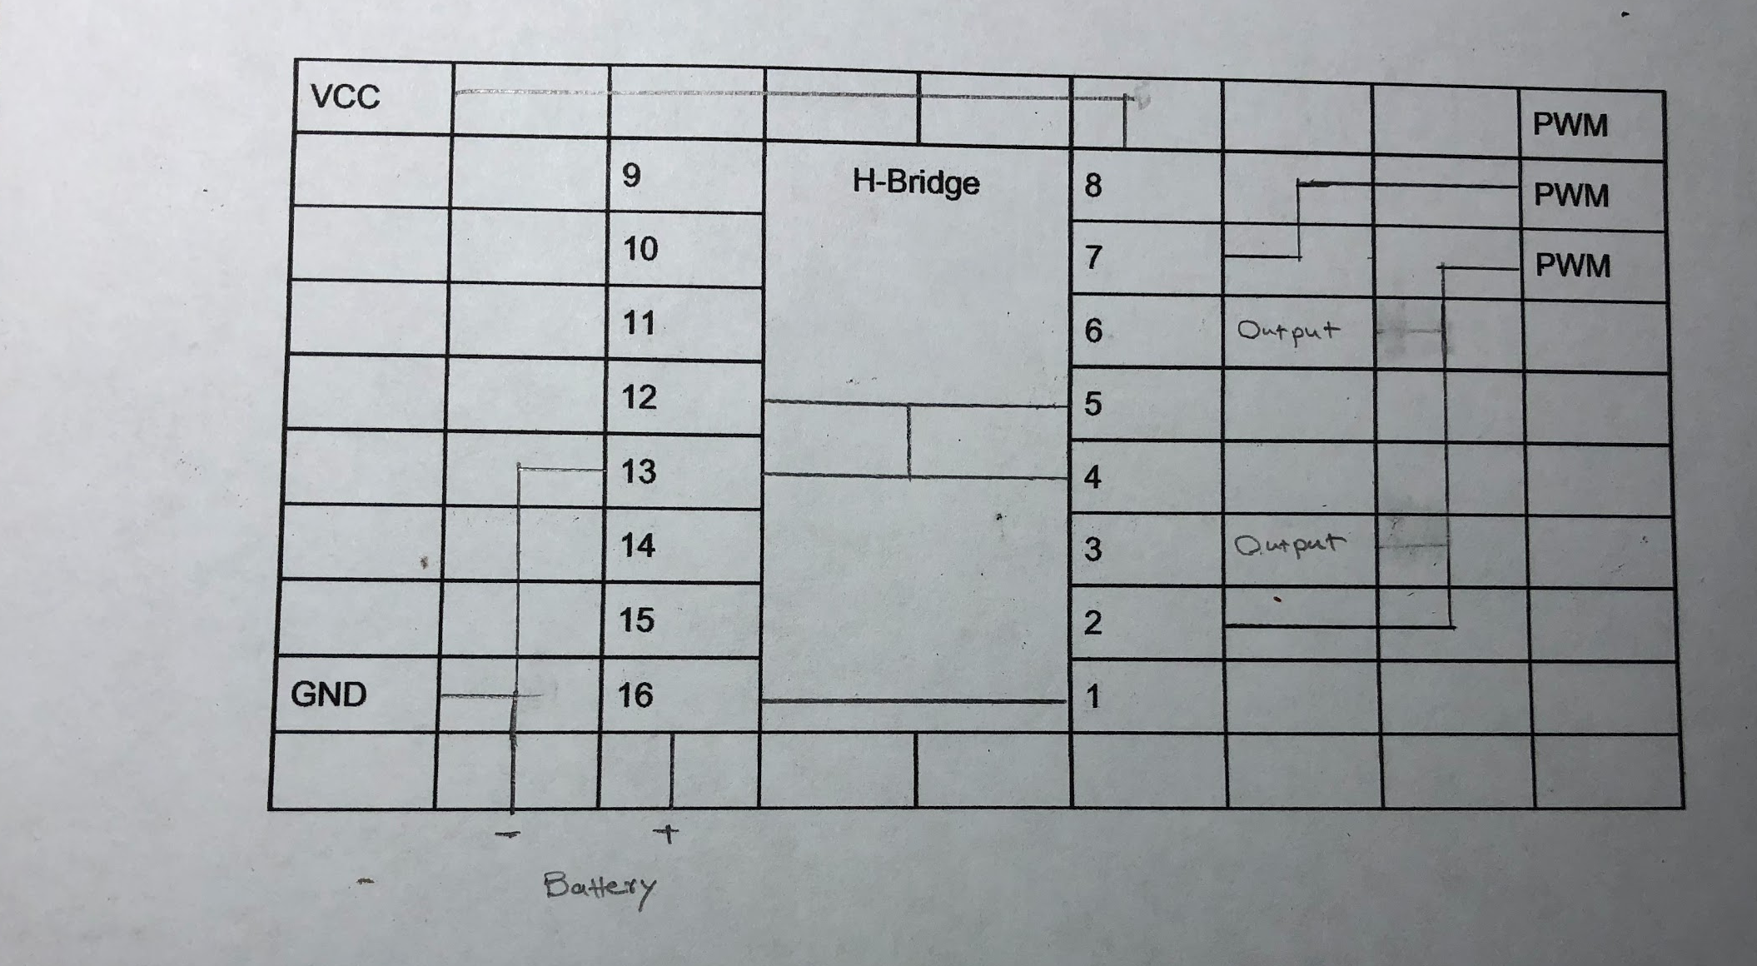
Testing the drone with controller attached part1
Demo link: https://youtu.be/24vi_tD_O_k
Notes:
Explain each component
Soldering of H-bridge and other components
Failure in test results --->3 volt VCC of the crazyflie to pin 8 of H-bridge → reroute battery with resistance

Slide 4
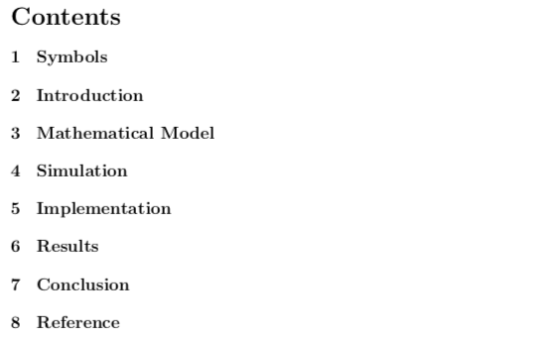
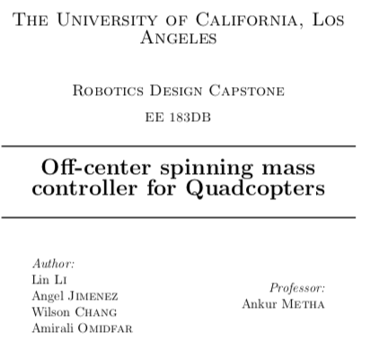
Documentation

Slide 5
Next Week Planning
Testing the model with drone+OCSM module attached (2)
Measure the accuracy of the controller
Documentation

Slide 6
References
https://www.bitcraze.io/2014/08/crazyflie-2-0-expansion-port/

